Slide 1


Baseball Tracking with the CEI Radar and Azure Kinect Camera
Joey Orr, Kevin Calhoun, and Jessica Vilarino
Advised by: Mark Jupina and George Simmons
Sponsored by: Colorado Engineering Inc.
https://coloradoengineering.com/
Notes:
ALL

Slide 2
Project Objectives
Problem: Players are not training effectively due to the lack of knowledge about pitch information
Goal: Design a system that allows baseball players to track a baseball pitch and determine whether it is a ball or strike
Key Features:
Unique strike zone for each batter
Path of pitch
Final location within strike zone
Notes:
Jess

Slide 3
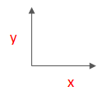


Overview of System
Azure Kinect Camera
(across from hitter)
CEI 77 GHz Radar unit, which tracks
the flight of the ball
~3 feet
~5 feet
~45 inches
Mound
~8 inches
x, y position of the ball is captured over 6 meters as a function of time
Home Plate
Notes:
Jess

Slide 4
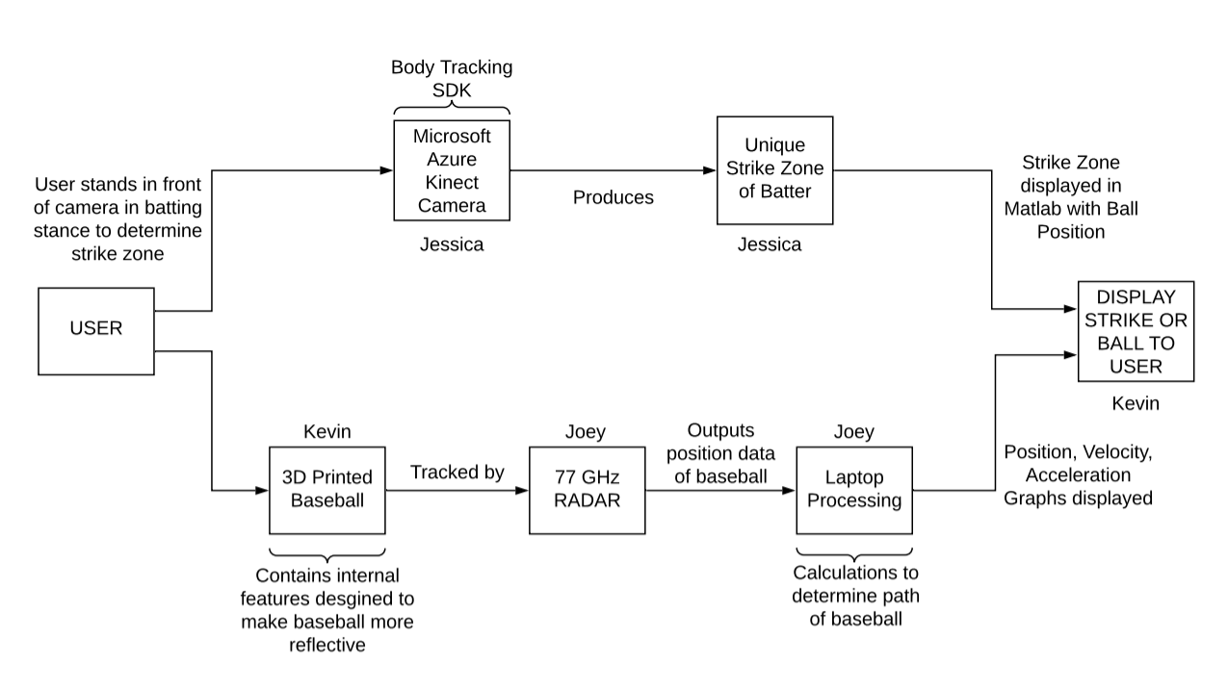
Block Diagram
Notes:
Kevin

Slide 5
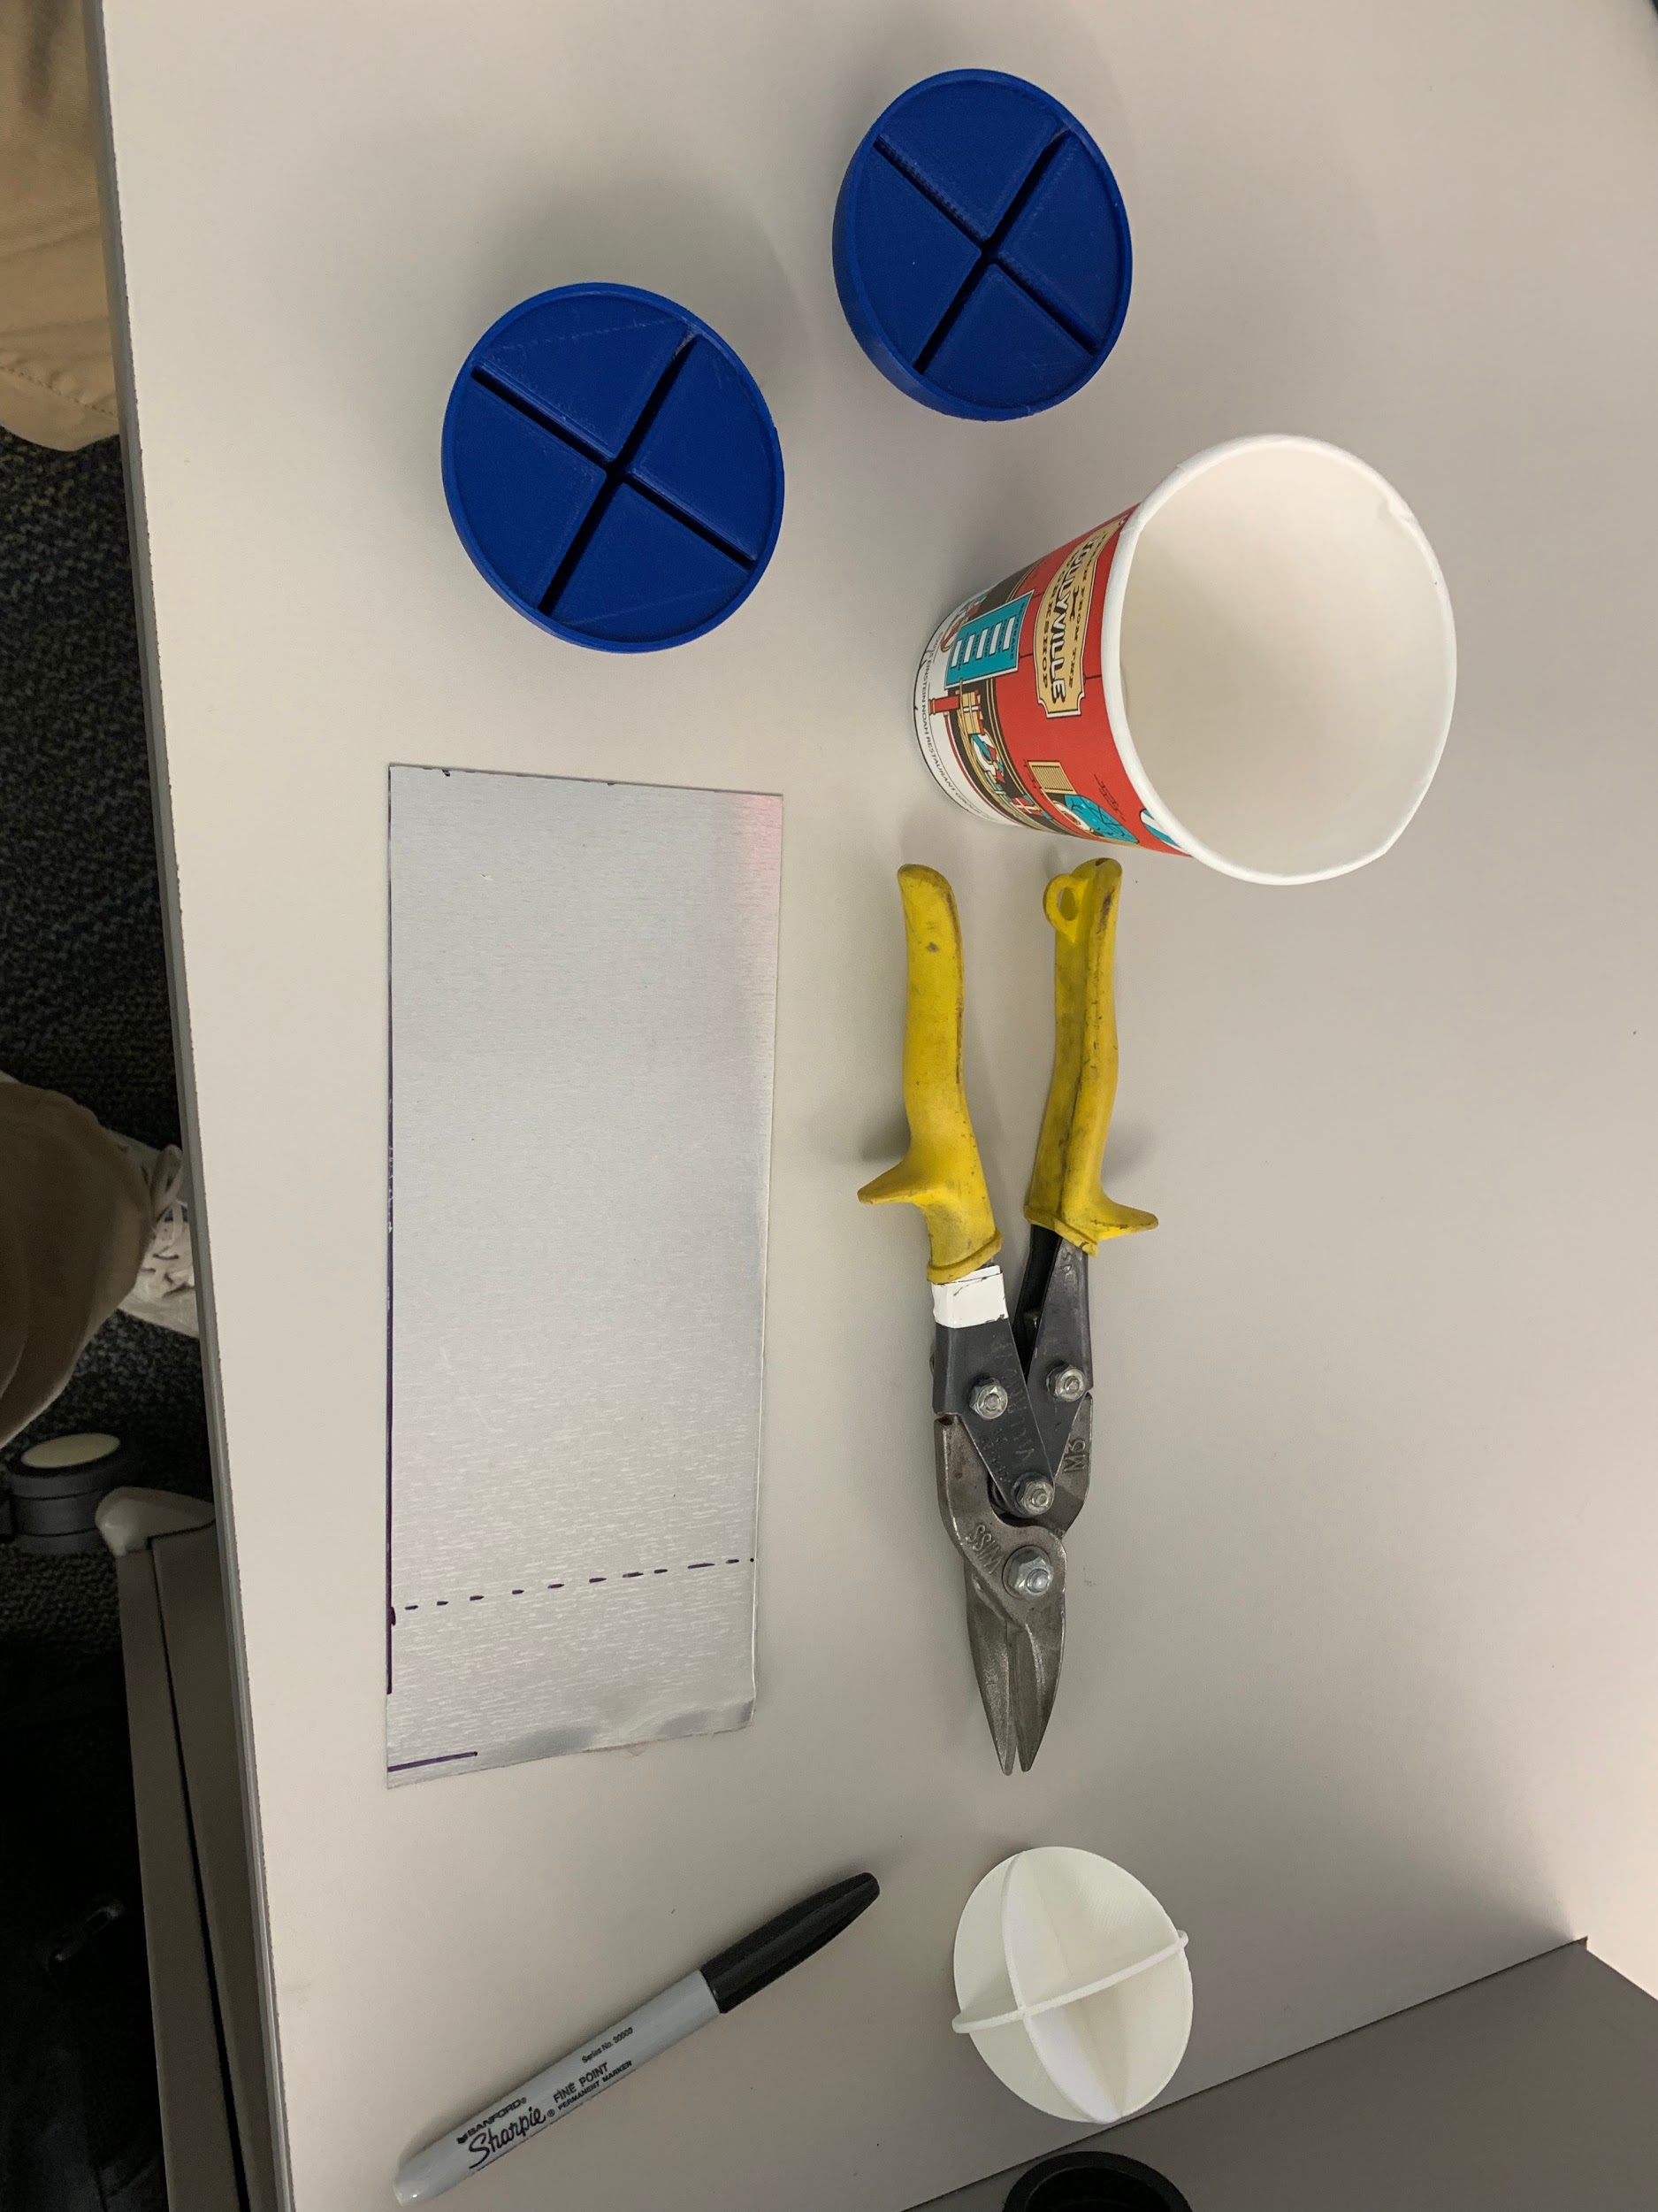
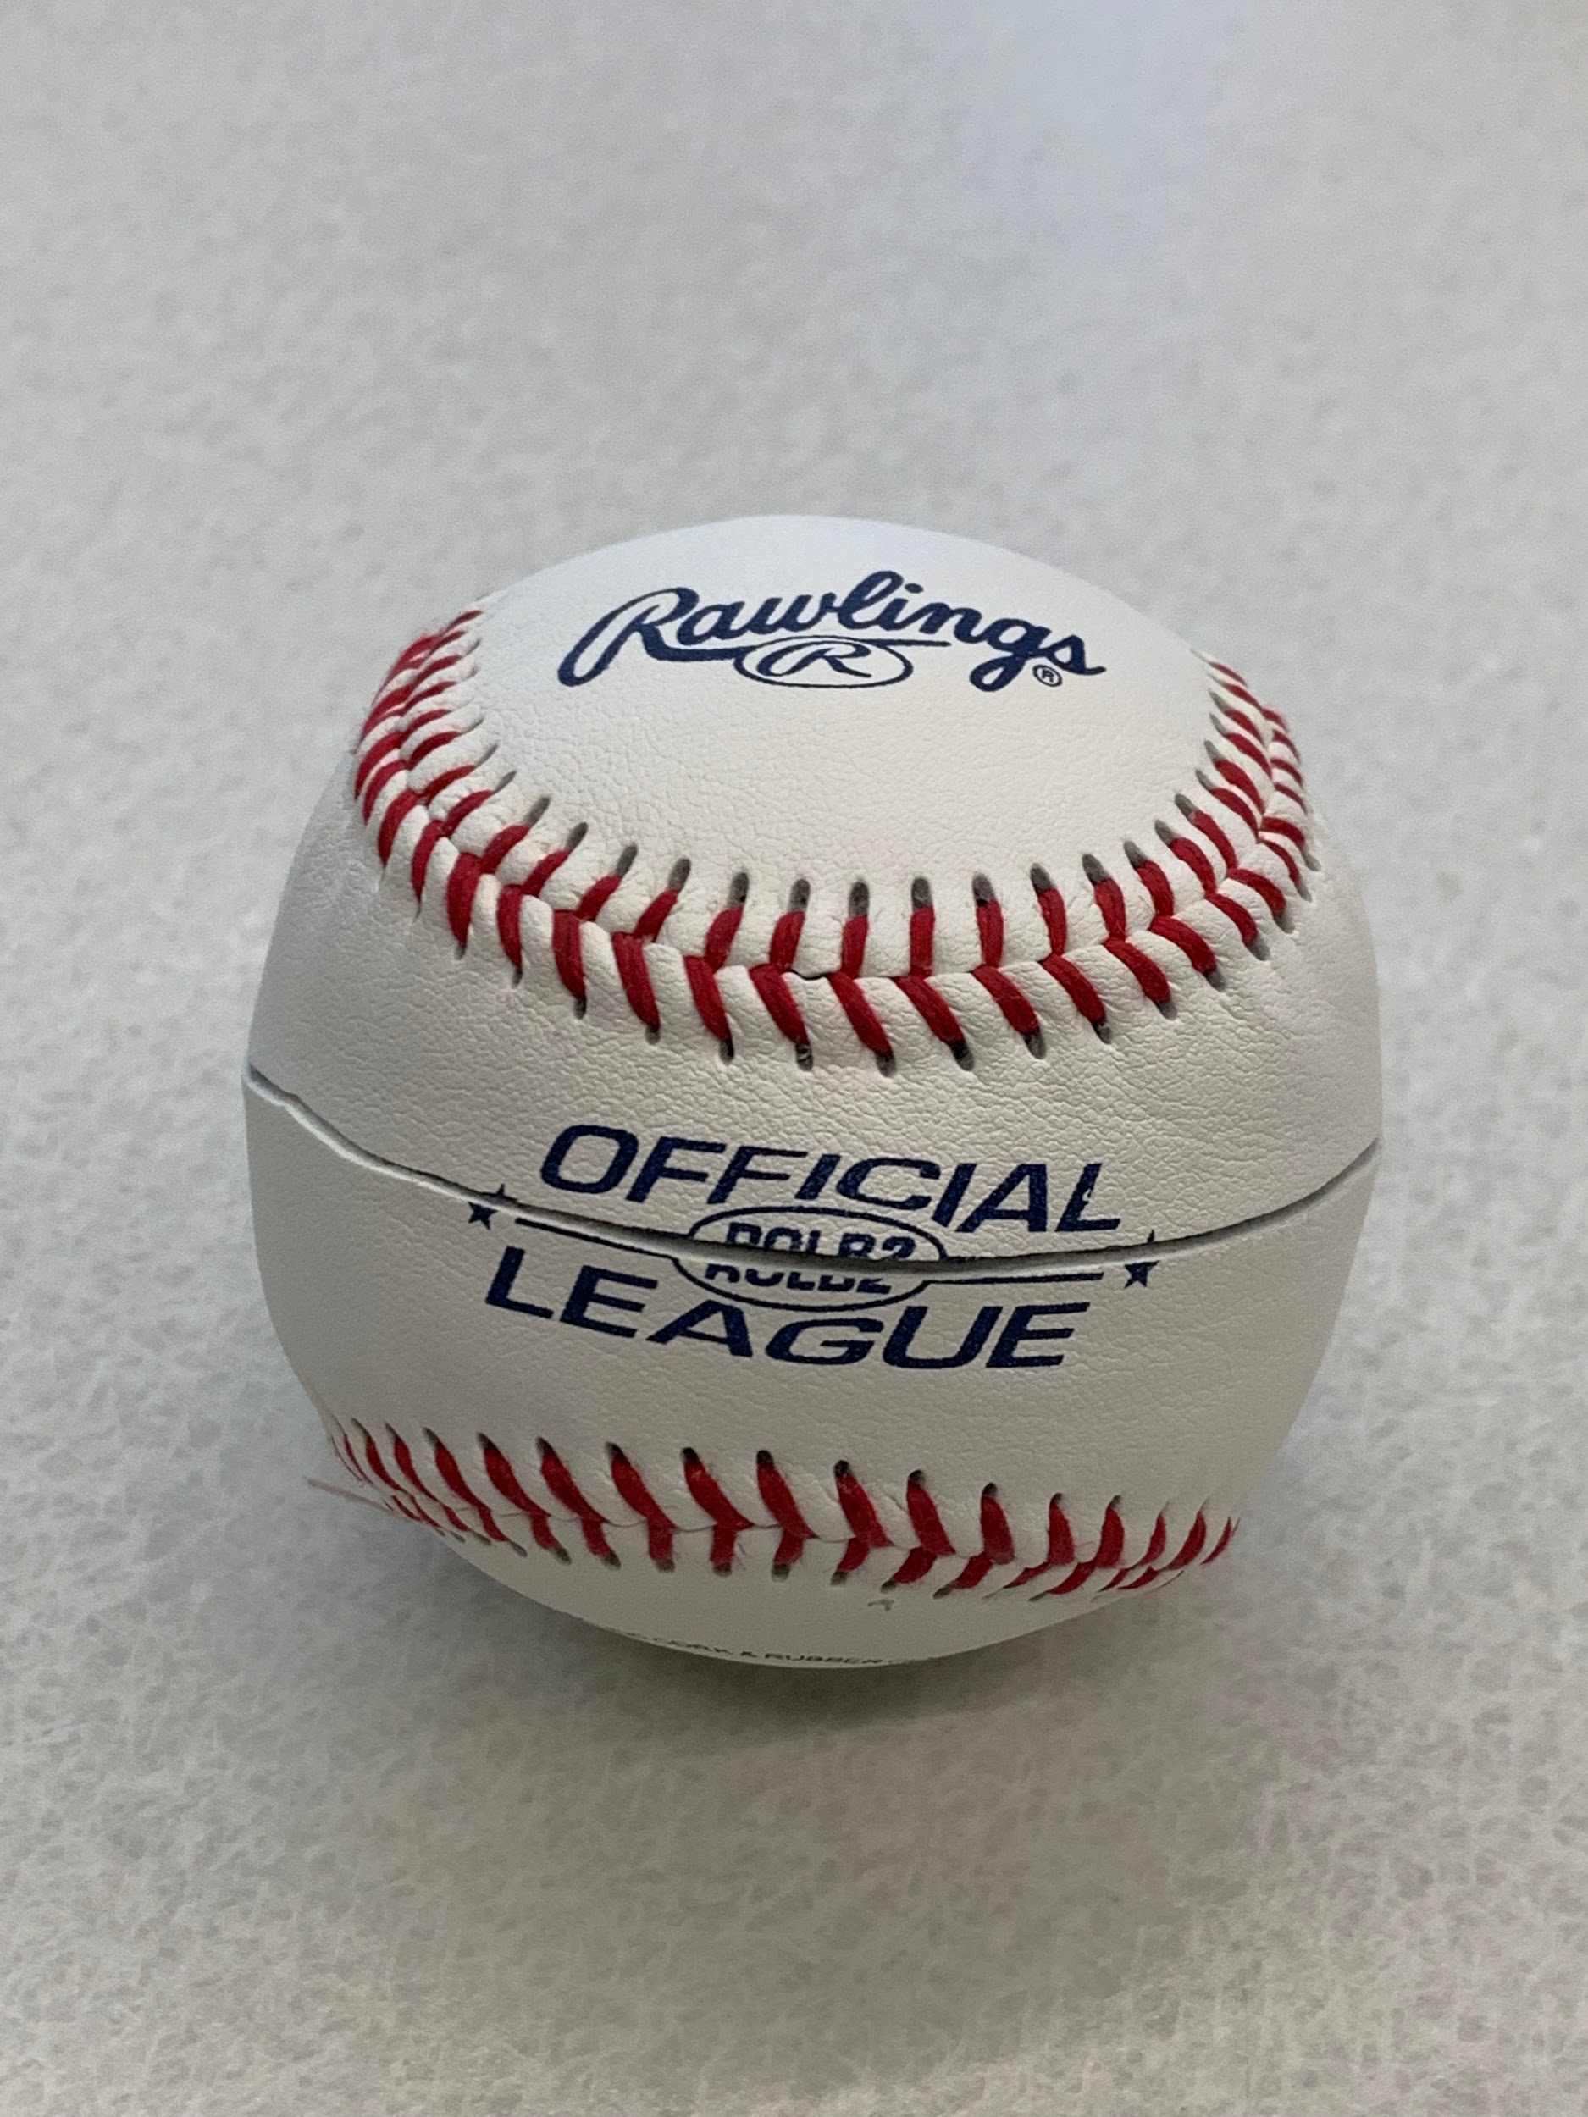
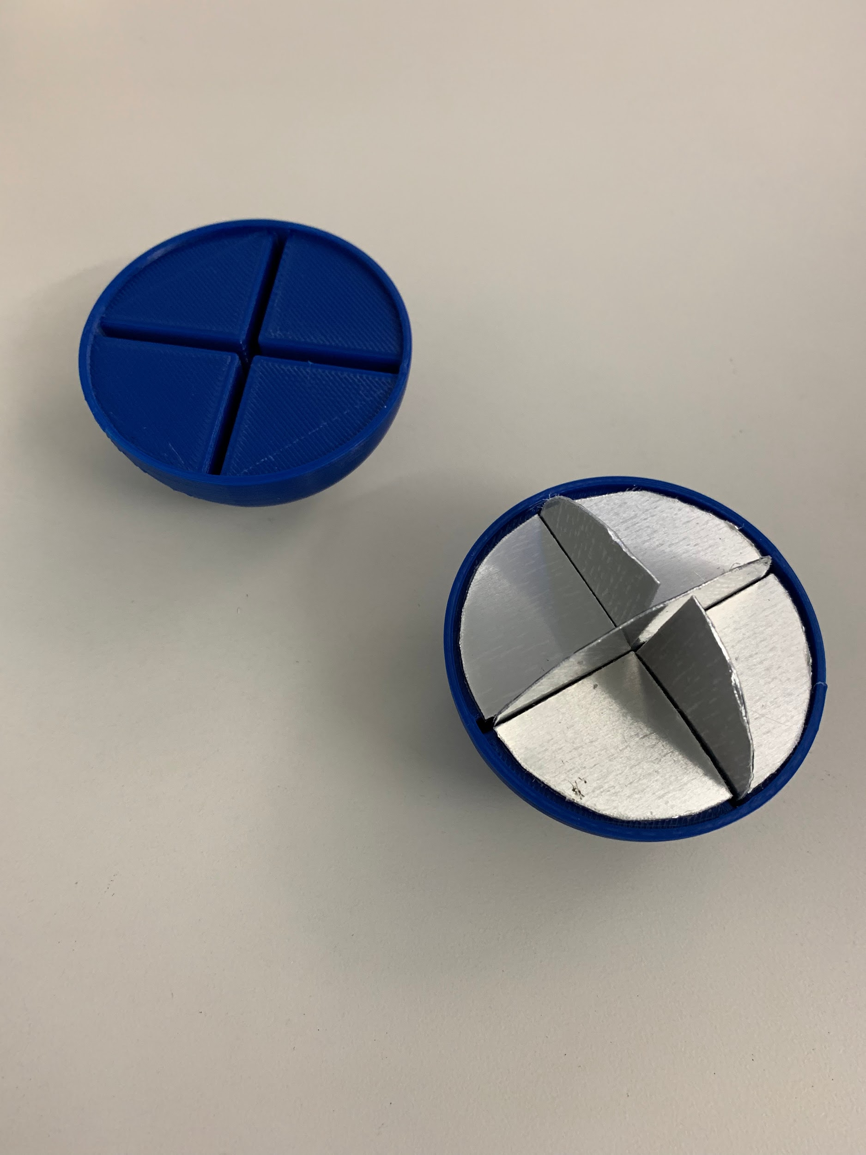
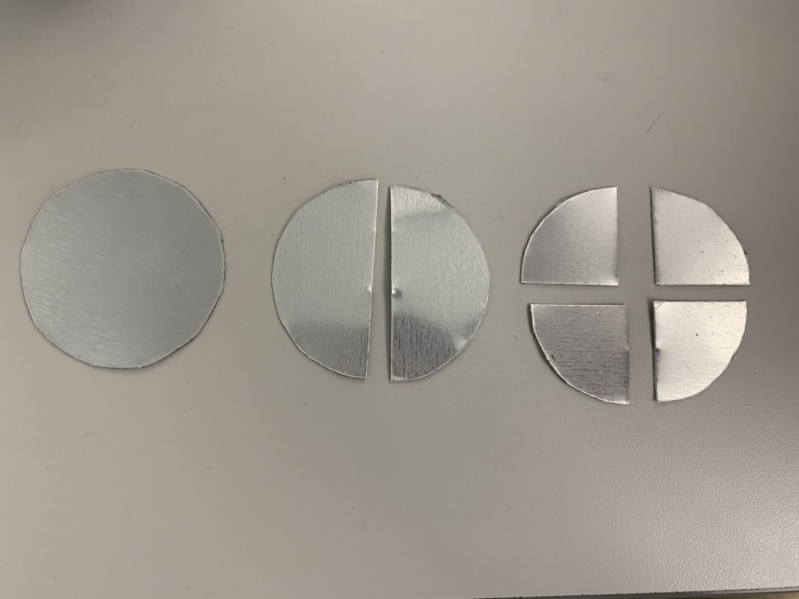
Photos of Baseball
Notes:
Kevin

Slide 6
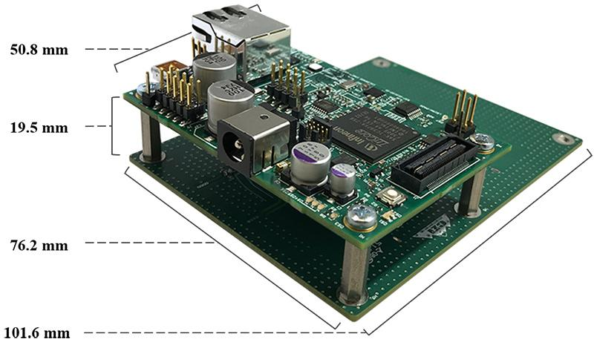
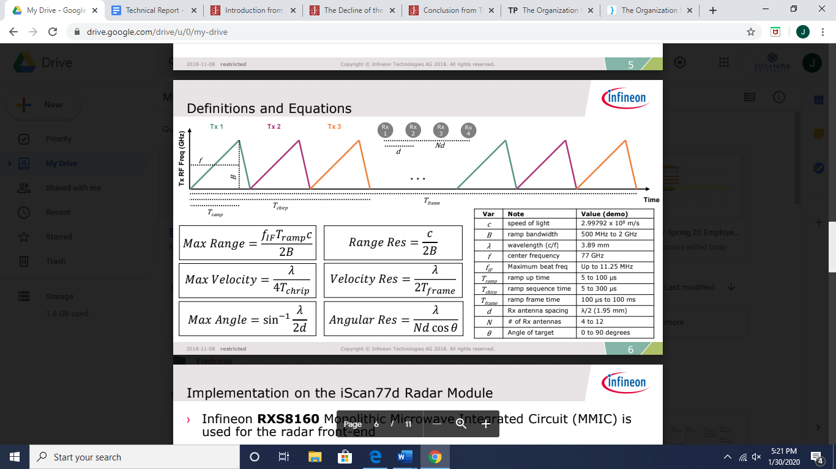
RADAR Subsystem
Designed for automotive uses
+/- 33° azimuth, +/- 5° elevation
Adjustable 500 MHz to 2 GHz bandwidth
B = 2e9 Hz
f_{IF} = 6.25e6 Hz
T_{ramp} = 1.1392e-4 s
T_{chirp} = 3.9043e-4 s
T_{frame} = 3.9043e-4 s
Notes:
Joey

Slide 7
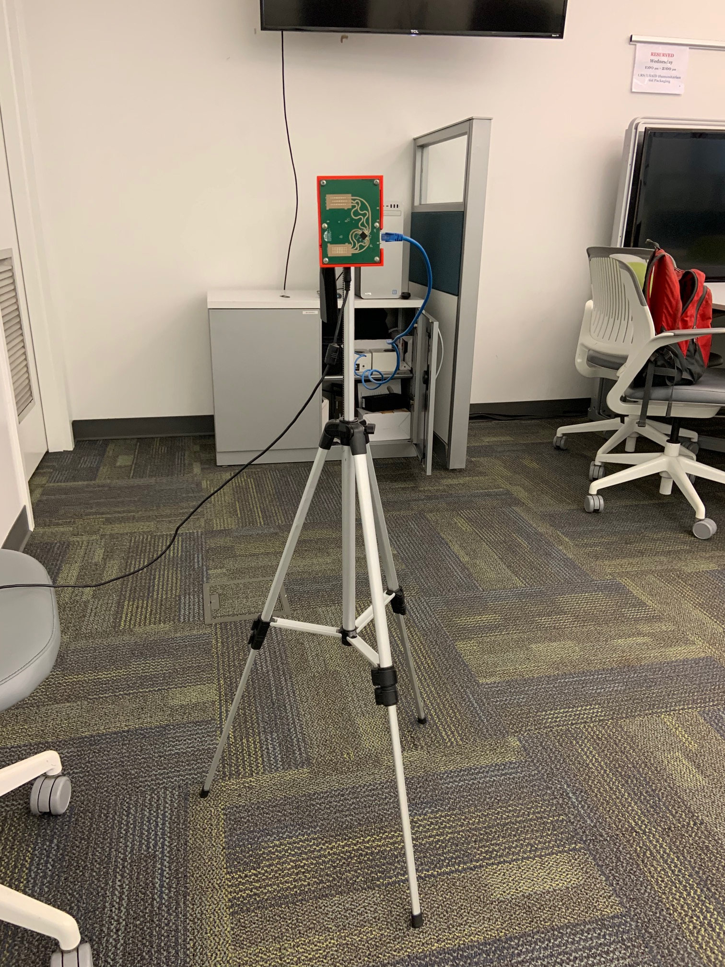
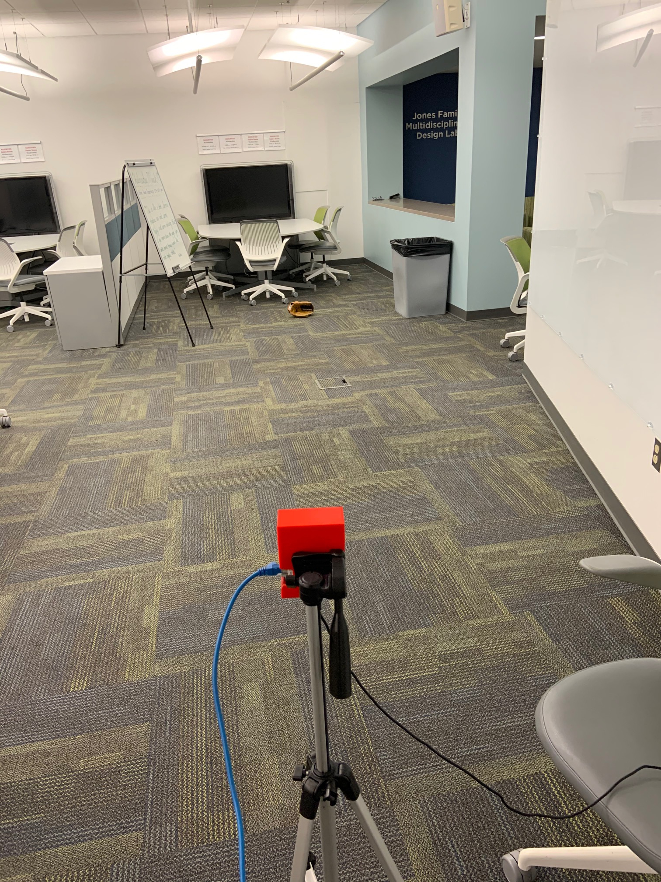
RADAR Implementation
Utilized example code provided by CEI
Zeroed out static background
Detected ball
Search for intensity blips
Extended maximum range and velocity
Notes:
Joey

Slide 8
Azure Kinect Camera Subsystem
Captured using Body Tracking SDK of Microsoft Azure Kinect Camera
Batter’s unique strike zone created based on the positional measurements of joints
Knees, chest, naval, feet and head
Captured catcher simultaneously without affecting the batter’s measurements
Measurements triggered when the foot of the batter is lifted
Connected via USB 3.0 to computer in the Multidisciplinary Lab (MDL)
Nvidia 1080 Graphics Card
Notes:
Jess

Slide 9
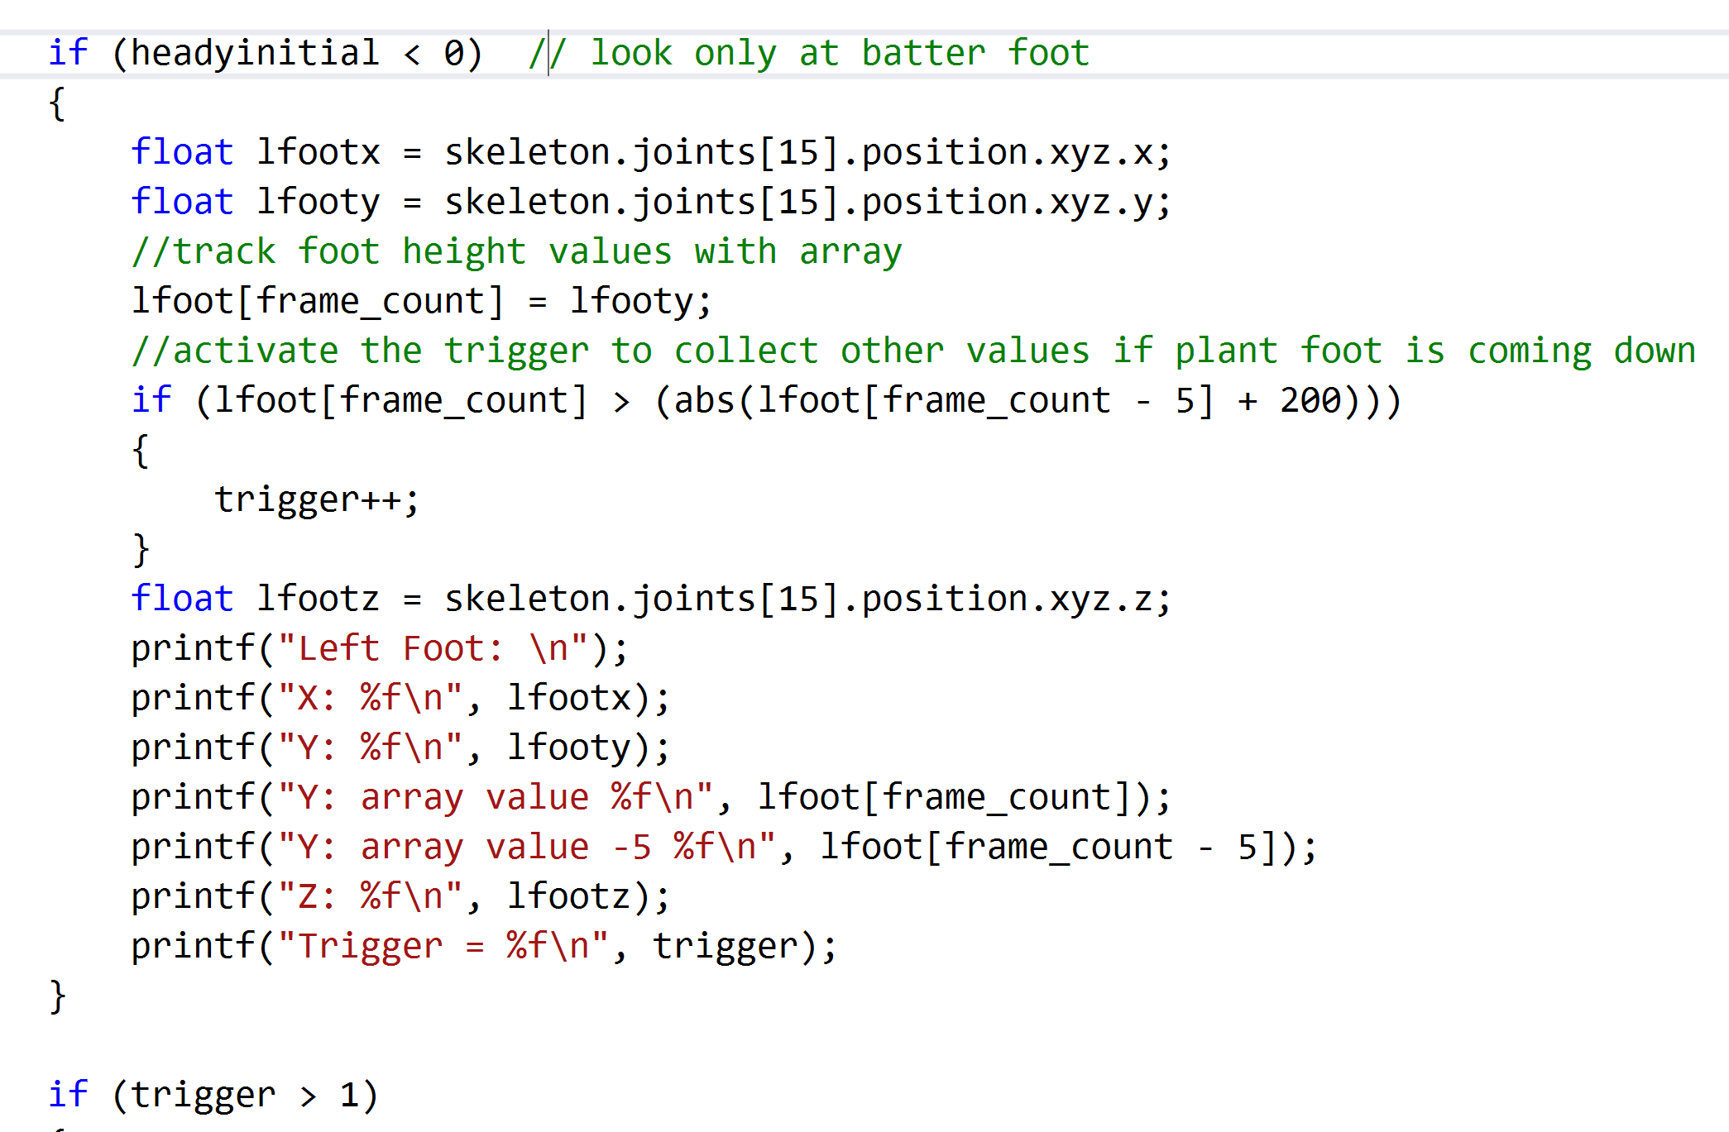
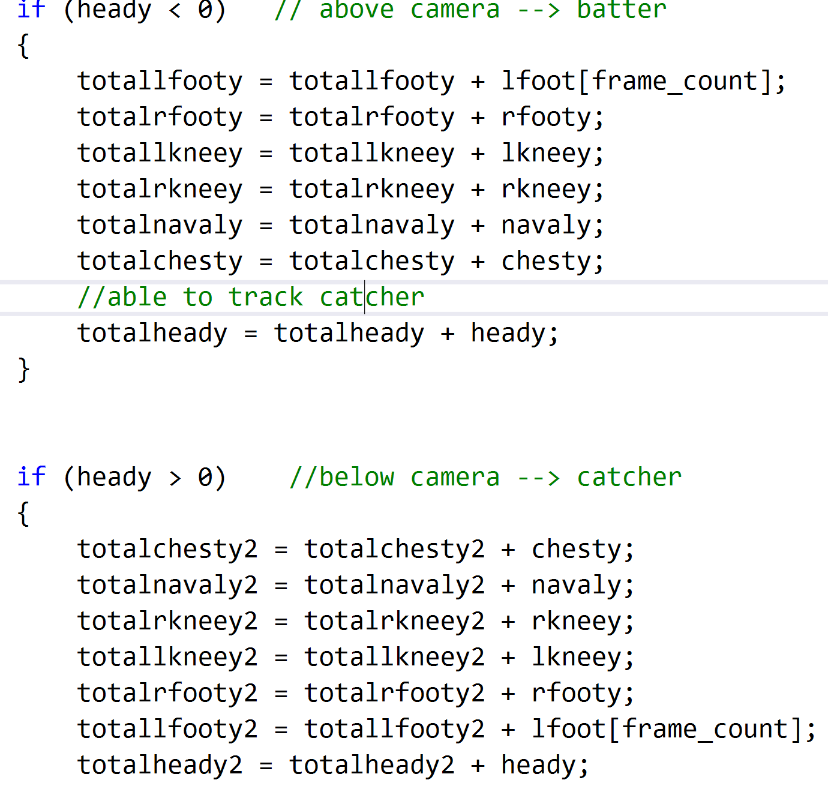
Camera Implementation
Trigger Code as Batter Lifts Foot
Separate Batter and Catcher Measurements
Notes:
Jess

Slide 10
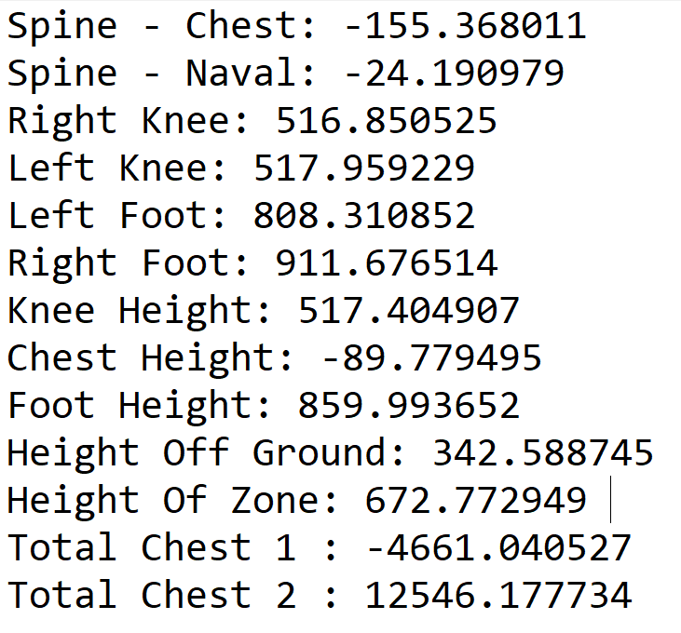
Camera Results
Average measurements for the batter over 30 frames (1 second)
Measured in mm and in relation to the camera
Positive Y axis points down
Predicted Measurements for Jessica:
Height of Zone: 610 mm
Height off Ground: 400 mm
Measurements read into Matlab to create 3D display of Strike Zone
Notes:
Jess

Slide 11
Determining Path and Location Subsystem
Feature 1:
Store x and y values of pitch in arrays with time values
Feature 2:
Filter through data and eliminate inaccurate points
Feature 3:
Take derivative of positional values to find velocity and acceleration
Notes:
Joey

Slide 12
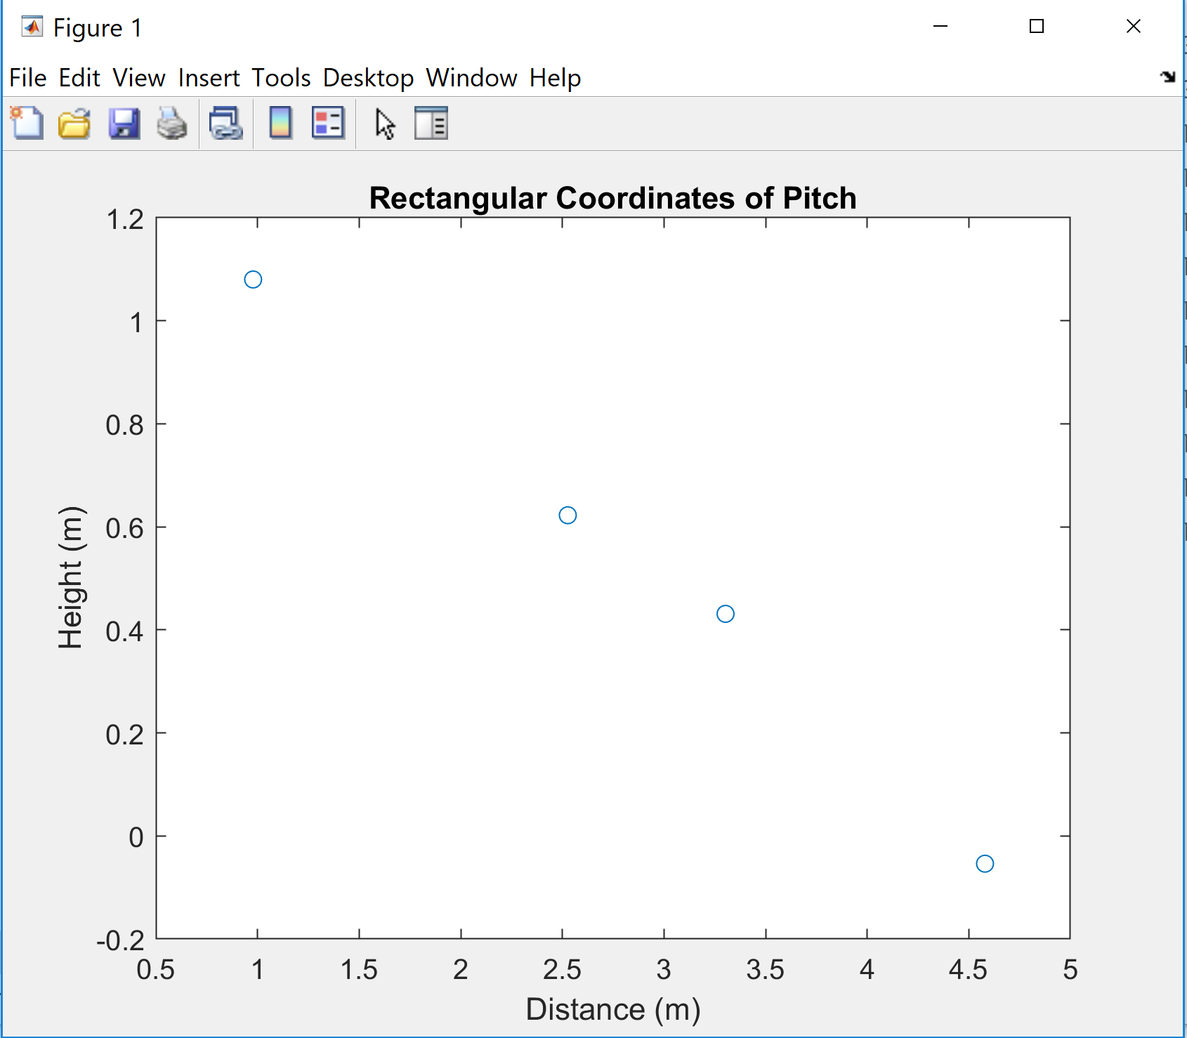
Results
Position and Predicted Velocity vs Time Graphs
Notes:
Joey

Slide 13
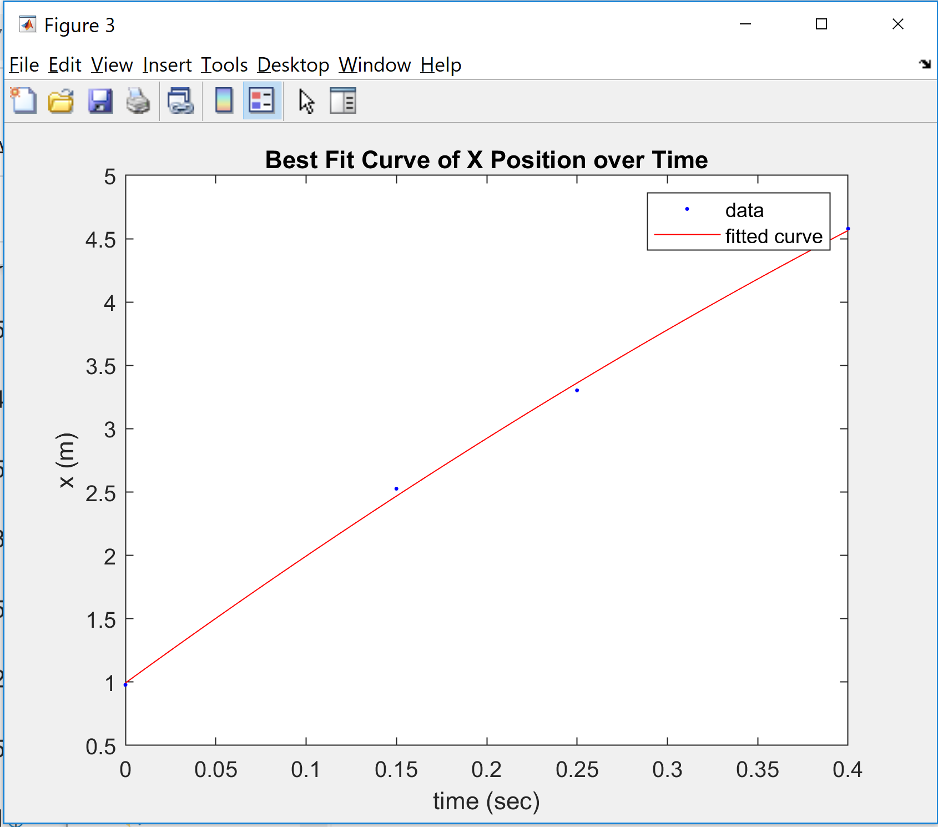
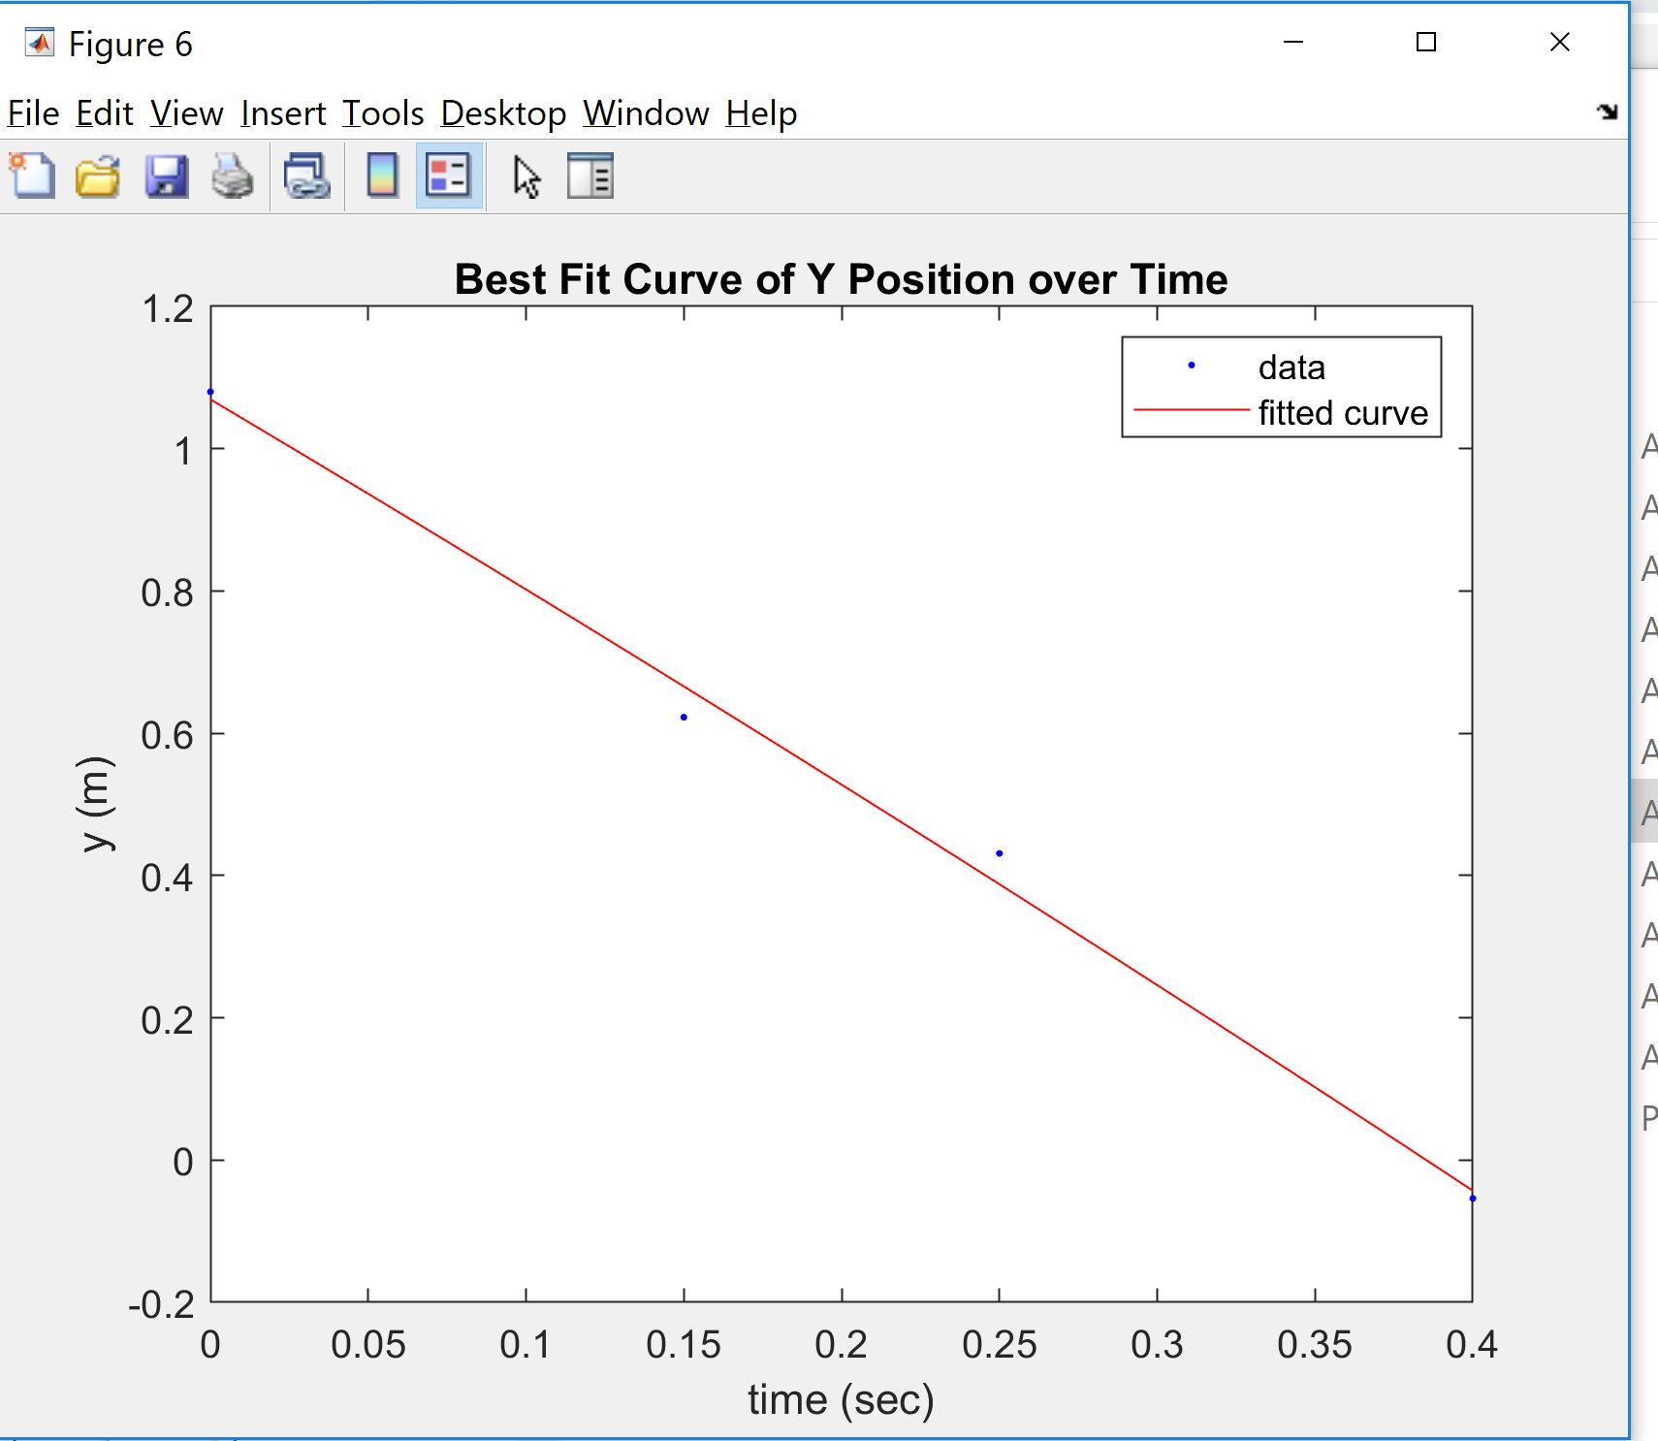
Results Cont.
Notes:
Joey

Slide 14
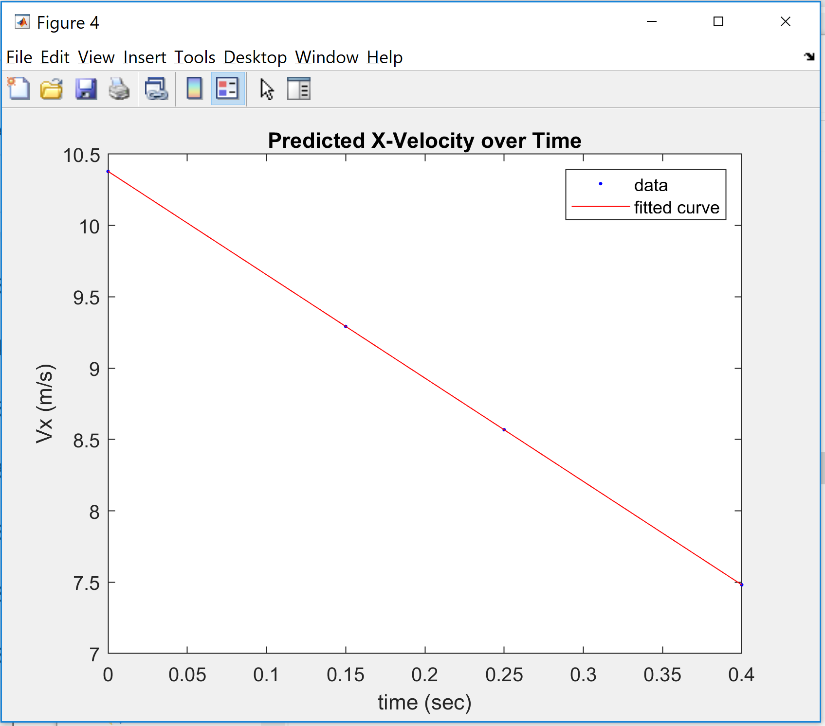
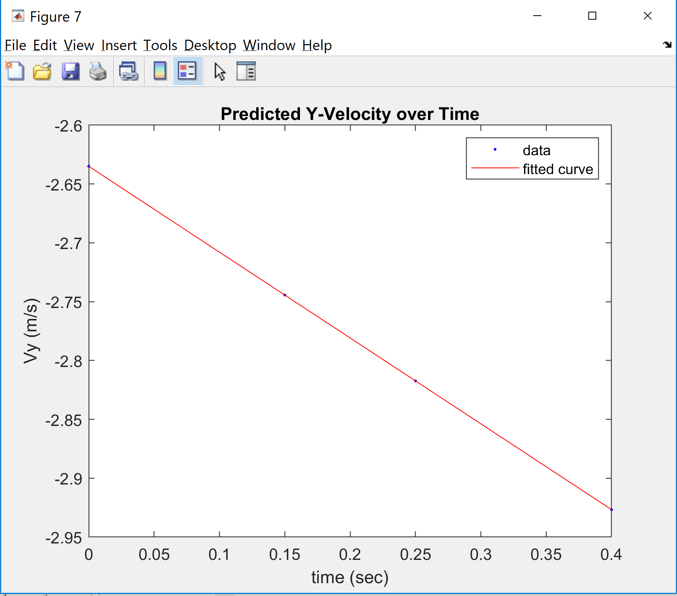
Results Cont.
Notes:
Joey

Slide 15
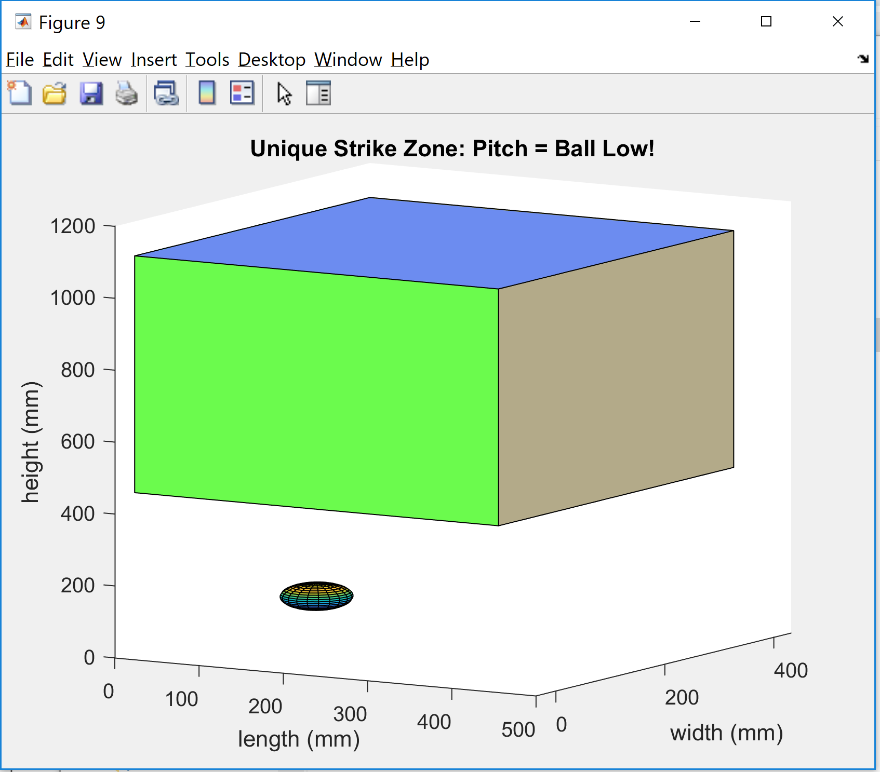
Results Cont.
Pitch demonstrated vs the unique strike zone
Code correctly detected the pitch as below the zone and a ball
Notes:
Kevin

Slide 16
Conclusions
Accurately tracked the path of a baseball pitch and classify whether it was a ball or strike
Could be used as an effective way for baseball players to train and improve their strike zone recognition
Future Improvements:
Increase frame rate of RADAR to track faster pitches with increased accuracy
TK-1 could be added to the system to process both the camera and RADAR
Notes:
Kevin

Slide 17


Acknowledgements
CEI
Larry Scally - ‘83 EE, ‘85 MSEE, ‘06 MBA
Sijia Qiu
Mike Bonato
Villanova University
Advisors: Dr. Mark Jupina and Prof. George Simmons
Clayton Bannan
Notes:
Kevin

Slide 18
Questions?

Slide 19
System Limitations
Only able to track baseball in two dimensions
When increasing the range of RADAR, sacrificed velocity resolution
RADAR cannot obtain both positional and velocity data simultaneously
Estimate of the velocity based on positional data
Outliers caused by noise can impact the best fit lines
Filters provided more consistency

